Slide 1

Database Security
Lecture 9
UECS 1203
DATABASE SYSTEM FUNDAMENTALS

Slide 2
Introduction
Main Aspect of Database Security Integrity
Confidentiality Availability
Access Control
Discretionary Access Control Mandatory Access Control
Conclusion
References

Slide 3
How to think about Insecurity?
May 16, 2014
3 / 42

Slide 4
How to think about Insecurity?
People are part of the problem...

Slide 5
How to think about Insecurity?
People are part of the problem... Bad guys don’t follow rules

Slide 6
How to think about Insecurity?
People are part of the problem... Bad guys don’t follow rules
Need to understand what sort of attack possible to compromise a system
Prerequisite to understand what to protect in a system!

Slide 7
Causes of Software Security Incidents
Buggy software and wrong configurations
Unsafe program languages Complex programs

Slide 8
Causes of Software Security Incidents
Buggy software and wrong configurations
Unsafe program languages Complex programs
Lack of awareness and education
Few courses in computer security
Programming text books do not emphasize security

Slide 9
Causes of Software Security Incidents
Buggy software and wrong configurations
Unsafe program languages Complex programs
Lack of awareness and education
Few courses in computer security
Programming text books do not emphasize security
Poor usability
Security sometimes makes things harder to use

Slide 10
Causes of Software Security Incidents
Buggy software and wrong configurations
Unsafe program languages Complex programs
Lack of awareness and education
Few courses in computer security
Programming text books do not emphasize security
Poor usability
Security sometimes makes things harder to use
Economic factors
Consumers do not care about security Security is difficult, expensive and takes time Few security audits

Slide 11
Causes of Software Security Incidents
Buggy software and wrong configurations
Unsafe program languages Complex programs
Lack of awareness and education
Few courses in computer security
Programming text books do not emphasize security
Poor usability
Security sometimes makes things harder to use
Economic factors
Consumers do not care about security Security is difficult, expensive and takes time Few security audits
Human Factor

Slide 12
Human Factor
Who are the attackers?

Slide 13
Human Factor
Who are the attackers?
Why do the attack systems?

Slide 14
What is Database security?
Database
It is a collection of information stored in a computer
Security
It is being free from danger
Database Security
It is the mechanisms that protect the database against intentional or accidentalthreats.
OR
Protection from malicious attempts to steal (view) or modify data.

Slide 15
What is Threats?
Threats - Any situation or event, whether intensional or accidental, that may adversely affect a system and consequently the organization.
Computer Systems Databases

Slide 16

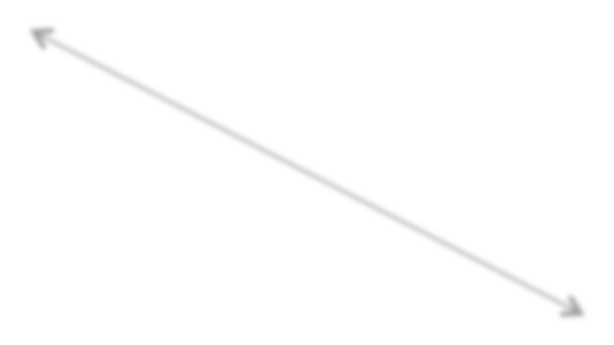




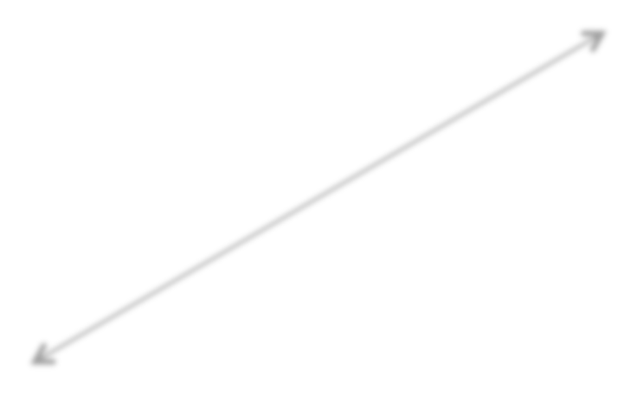

Threats
Hardware
Fire/Flood/bombs
Data corruption due to power loss or surge
Failure of security mechanisms giving greater access
Theft of equipment
Physical damage of equipment
DBMS and Application Software
Failure of security mechanism giving greater access Program alteration
Theft of programs
Communication Networks
Wire tapping
Breaking or disconnection of cables Electronic interference and radiation
Database
Unauthorized amendment or copying of data
Theft of data
Data corruption due to power loss or surge

Slide 17

Threats
Hardware
Fire/Flood/bombs
Data corruption due to power
loss or surge
Failure of se giving great Theft of equ Physical da
Communi Wire tappin Breaking or
curity mechanisms r access
pment
age of equipment
ation Networks
DBMS and Application S
Failure of security mechanis giving greater access Program alteration
Theft of programs
oftware
User
_{e} Programmers/
Data/Database Administrator
Inadequate security
Policies and procedures
m
Using another person’s means of access
Viewing and disclosing unauthorized data
Inadequate staff training
Illegal entry by hacker
Blackmail
Introduction of viruses
_{i} Operators
m o Creating trapdoors
Program alteration (such as creating software that is insecure)
Inadequate staff training
Inadequate security policies and procedure
c
Database
Unauthorized amendment or copying of data
Theft of data
Data corruption due to power loss or surge
g
disconnection of cables
Electronic interference and radiation

Slide 18
Definition of Database security
Database Security is defined as the process by which ”Confidentiality, Integrity, andAvailability”of the database can be protected
Countermeasures authorization access control views
backup and recovery encryption
RAID technology

Slide 19
Database security Concepts
Three Main Aspects
Confidentiality Integrity Availability
Threats to databases:
Loss of Integrity
Loss of Availability
Loss of Confidentiality

Slide 20
Confidentiality
Confidentiality
No one canreadourdata/communicationunless we want them to It is protecting the database fromunauthorizedusers.
Ensures that users are allowed to do the things they are trying to do. For example:
The employees should not see the salaries of their managers.

Slide 21
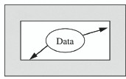
Confidentiality
Confidentiality involves:
privacy:protection of private data, secrecy:protection of organisational data

Slide 22
Integrity
Integrity
No one canmanipulateourdata/processing/communicationunless we want them to
Protecting the database fromauthorizedusers. Ensures that what users are trying to do iscorrect For example:
An employee should be able to modify his or her own information.

Slide 23
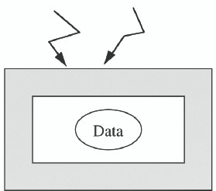
Integrity
”Making sure that everything is as it is supposed to be.”
Preventing unauthorized writing or modifications

Slide 24
Availability
Availability
We canaccessourdata/ conduct ourprocessing/ use our communicationcapabilities when we want to
Authorized users should be able to access data for Legal Purposes as necessary
For example:
Payment orders regarding taxes should be made on time by the tax law.

Slide 25
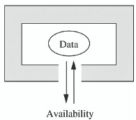
Availability
Services are accessible and useable (without delay) whenever needed by an authorized entity.

Slide 26
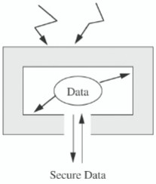
Relationship between Confidentiality Integrity and Availability

Slide 27
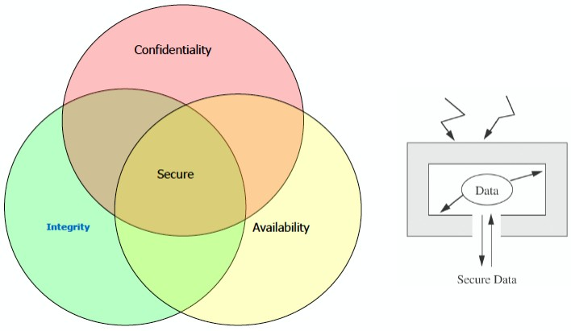
Relationship between Confidentiality Integrity and Availability

Slide 28
Integrity
How is data integrity preserved?
Through Data integrityConstraints
Constraints restrict data values that can be inserted or updated

Slide 29
Column CHECK constraints
Example
Validity Checking Example
CREATE TABLE test
(rollno number(2) check (rollno between 1 and 50), name varchar2(15));
Validity Checking Example
INSERT INTO test values(45, ’ Willy’ ); 1 row inserted
Validity Checking Example
INSERT INTO test values(55, ’ Hiess’ ); ERROR-Check constraints violated

Slide 30
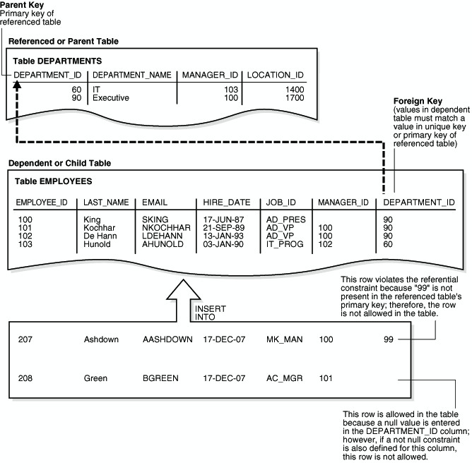
Referential Integrity
Ghezal Ahmad Zia (@ISD-CSF-KU)
May 16, 2014
30 / 42
Database Security

Slide 31
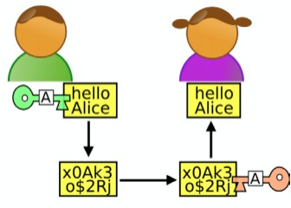
Confidentiality
Example: How to ensure data confidentiality?
Cryptography
Strong Access Control
Limiting number of places where data can appear

Slide 32
Access Control
An identity permits access to resources In computer security this is called
Access Control Authorization
We talk about:
Subjects (for whom an action is performed) Objects (upon what an action is performed) Operations (the type of action performed)

Slide 33
Access Control Models
A DBMS providesaccess controlmechanisms to help implement a security policy.
Two complementary types of mechanism:
1
Discretionary access control (DAC)
Mandatory access control (MAC)
2

Slide 34
Discretionary Access Control
Idea
Achieve security based on the concept of access rights:
privileges for objects (certain access rights for tables, columns, etc.), and
a mechanism for giving users privileges (and revoking privileges)
Users are given privileges to access the appropriate schema objects (tables, views).
Users can grant privileges to other users at their own discretion. Implementation: GRANT and REVOKE commands

Slide 35
Granting/Revoking Privileges
GRANT SELECT ON database.* TO user@’localhost’;

Slide 36
Granting/Revoking Privileges
GRANT SELECT ON database.* TO user@’localhost’;
GRANT SELECT ON database.* TO user@’localhost’ IDENTIFIED BY ’password’;

Slide 37
DBMSs and Web Security
Countermeasures
Proxy servers
Firewalls
Secure Socket Layer or SSL

Slide 38
DBMSs and Web Security
Countermeasures
Proxy servers
Firewalls
Secure Socket Layer or SSL Which is used extensively to secure e-commerce on the Internet today.

Slide 39
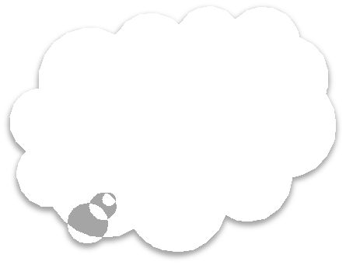





Proxy Servers
Definition
Proxy servers is a computer that sits between a Web browser and a Web servers. It intercepts all requests for web pages and saves them locally for some times. Proxy server provides improvement in performance and filters requests.
Computer A
Proxy-server
Internet
Computer B

Slide 40
Firewalls
Firewalls
Is a system that prevents unauthorized access to or from private network.
Implemented in software, hardware or both.
Packet filter Application gateway Proxy server

Slide 41
Conclusion
Data security is critical.
Requires security at different levels. Several technical solutions .
But human training is essential.

